Slide 1
XSS DOM ATTACK
Krishnaa S (2020506045) Jawahar Thamizharasi

Slide 2
INTRODUCTION
This presentation delves into Cross-Site Scripting (XSS) and DOM-based attacks, both critical web security concerns. XSS exploits trust between users and websites to inject malicious scripts, while DOM-based attacks manipulate the Document Object Model using client-side scripting. Understanding these vulnerabilities is crucial for safeguarding web applications against these potential threats.

Slide 3
OBJECTIVES
Understanding Vulnerabilities: Gain insight into the nature and mechanics of Cross-Site Scripting (XSS) and DOM-based attacks.
Vulnerability Types: Differentiate between Stored, Reflected, and DOM-based XSS attacks, comprehending their distinct characteristics.
Preventive Strategies: Explore strategies such as input validation, output encoding, and Content Security Policy (CSP) to mitigate the risks of XSS and DOM attacks.
Detection Techniques: Investigate methods and tools for identifying XSS and DOM vulnerabilities, enabling proactive defense against potential attacks.
Real-world Insights: Analyze real-world cases of notable attacks to grasp the potential consequences and implications of these vulnerabilities.

Slide 4
LITERATURE SURVEY
The paper proposes JSCSP, a JavaScript-based solution that can automatically generate and enforce self-defined security policies for web applications to prevent XSS attacks.
XSS attacks are a common web application vulnerability that allow attackers to inject and execute malicious scripts on the browsers of unsuspecting users, compromising their security and privacy.
JSCSP is better than CSP, a W3C standard that restricts the sources and types of content that can be loaded and executed on web pages, because JSCSP is compatible with most browsers, can generate policies automatically, and can enforce fine-grained and cascading policies.

Slide 5
LITERATURE SURVEY
The paper evaluates JSCSP on various web applications and compares it with other XSS defense solutions, such as NoScript, ScriptSafe, XSS Auditor, and CSP. The results show that JSCSP can detect and block more XSS attack vectors than other solutions, while having minimal impact on the web page’s functionality and performance.
The paper also discusses some limitations and future work of JSCSP, such as improving its policy generation algorithm, enhancing its detection and prevention capabilities, and resolving its compatibility issues with other JavaScript components.

Slide 6
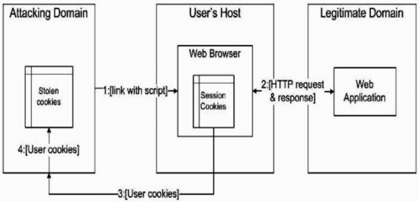
ARCHITECTURE DIAGRAM

Slide 7
BENEFITS
Uncompromised User Confidence: Mitigating XSS and DOM vulnerabilities fosters user trust, ensuring their confidence in your application's security and reliability.
Preserved Data Integrity: By neutralizing these threats, you maintain the integrity of user data, preventing unauthorized access and tampering.
Enhanced Brand Reputation: A secure application reflects positively on a brand, positioning the owner as a responsible and security-conscious provider.
Reduced Legal and Financial Risk: Preventing attacks helps you avoid potential legal liabilities and financial losses that can arise from data breaches or compromised user information.

Slide 8
THANK YOU

